Slide 1

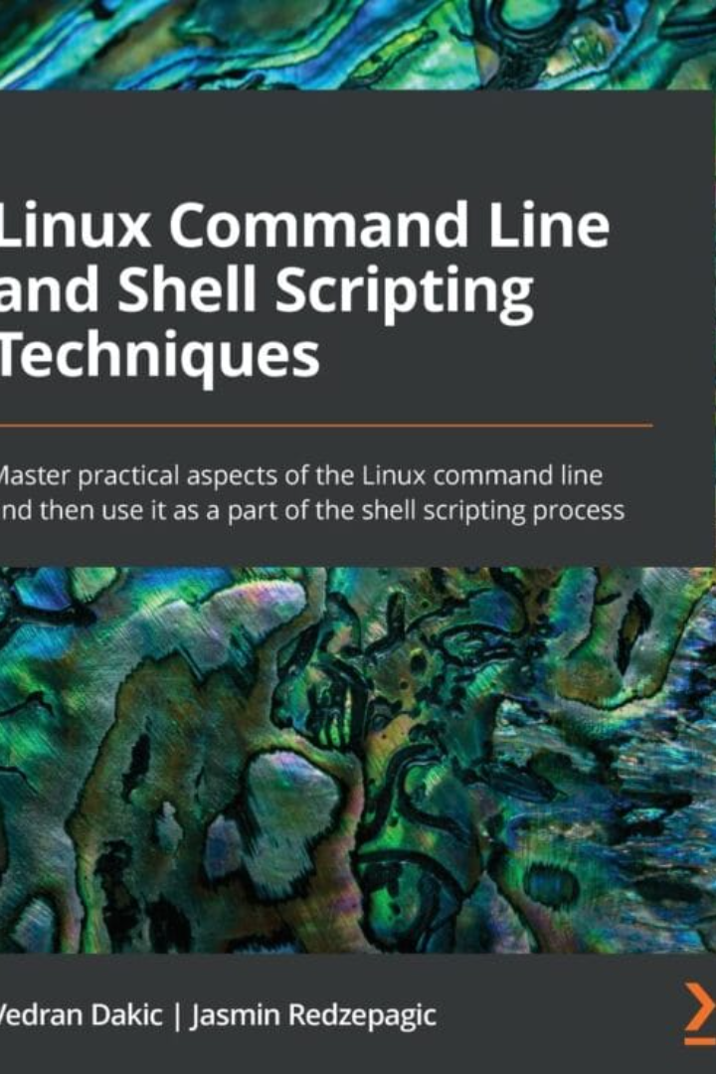

Linux File Commands
Welcome to the world of Linux file management! In this presentation, we'll explore 10 essential Linux file commands that will help you navigate, create, copy, move, and manage files and directories efficiently.
by HUSNAARA HUSHU
HH

Slide 2
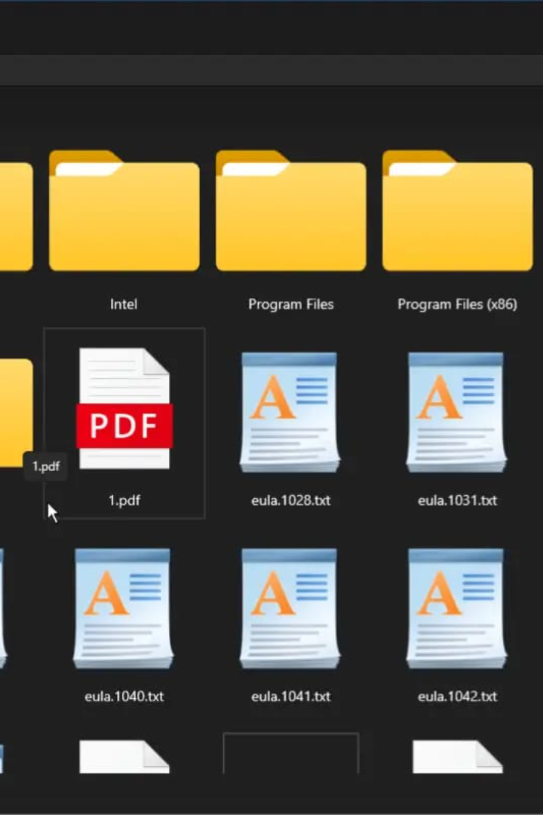
ls - List Files and Directories
The ls command lists files and directories in the current directory.
Usage: ls [options]
Example: ls -l /path/to/directory

Slide 3

cd - Change Directory
The cd command allows you to change your current working directory.
Usage: cd /path/to/directory
Example: cd /home/user/documents

Slide 4
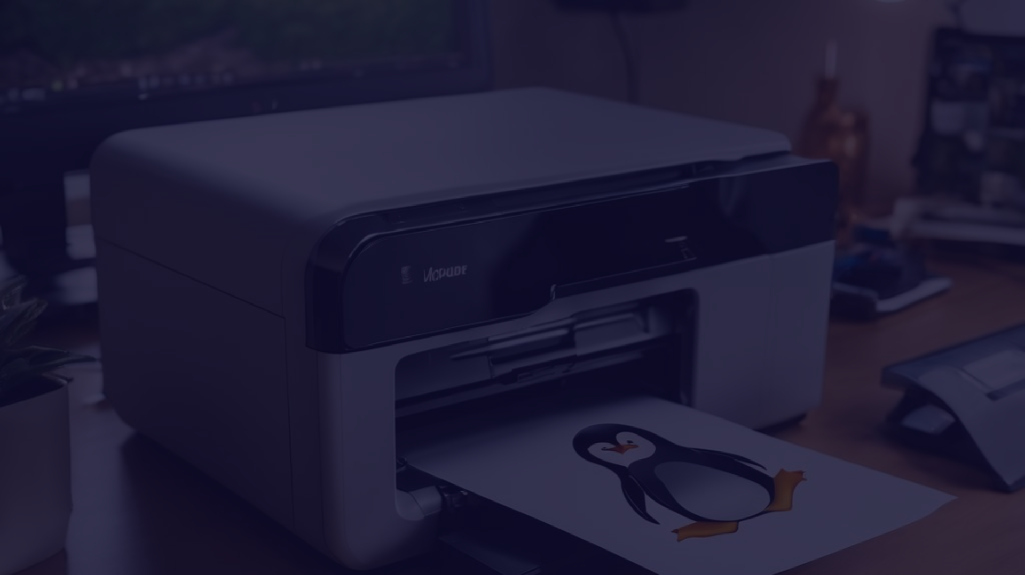
pwd - Print Working Directory
The pwd command prints the current working directory to the screen.
Usage: pwd
Example: pwd

Slide 5
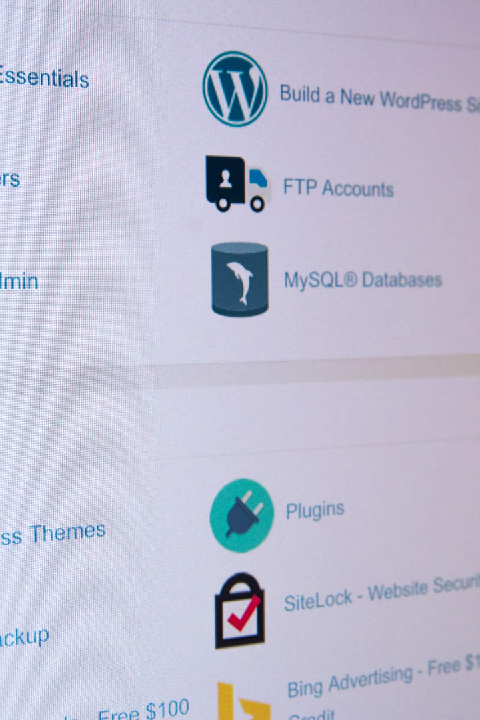
touch - Create or Update Files
Use the touch command to create an empty file or update the timestamp of an existing file.
Usage: touch filename
Example: touch newfile.txt

Slide 6
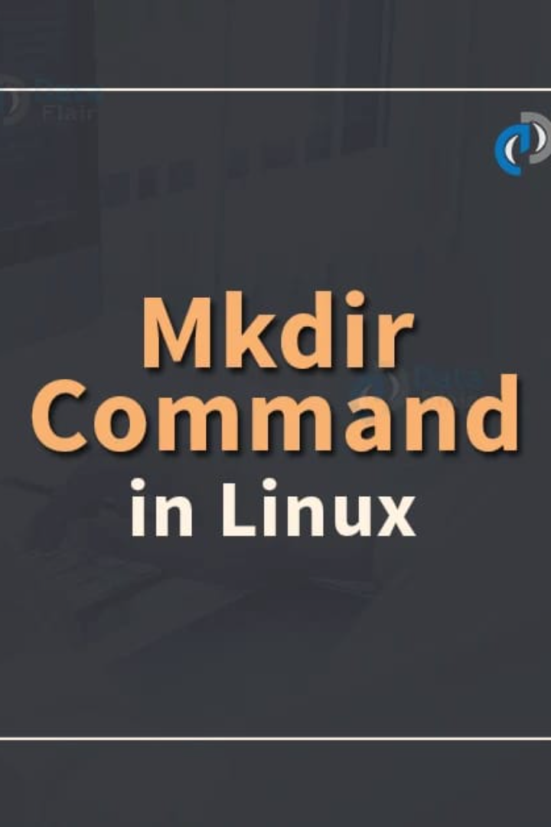
Create Directories
The mkdir command is used to create new directories.
Usage: mkdir directoryname
Example: mkdir new_directory

Slide 7
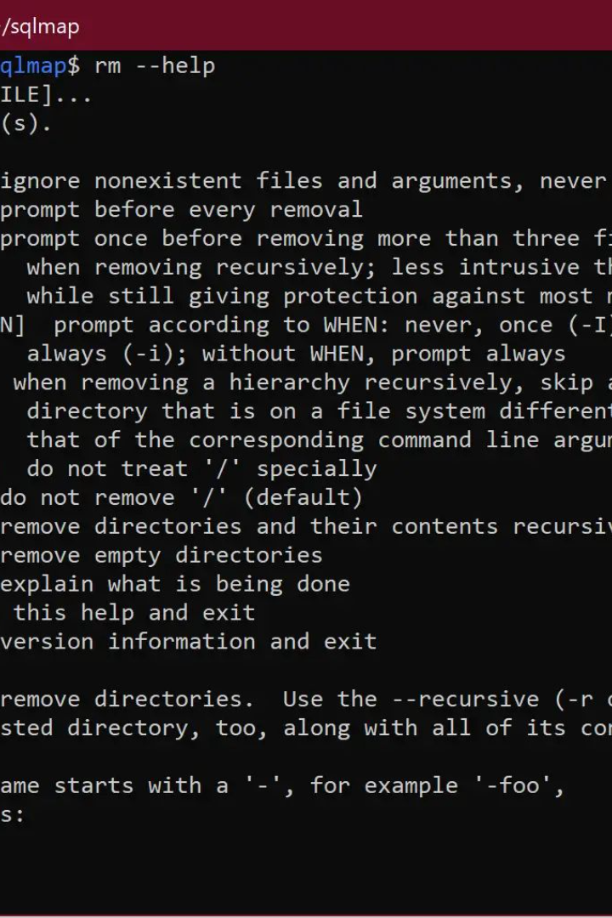
rm - Remove Files and Directories
The rm command allows you to remove files and directories.
Usage: rm filename or rm -r directoryname
Example: rm oldfile.txt or rm -r old_directory

Slide 8
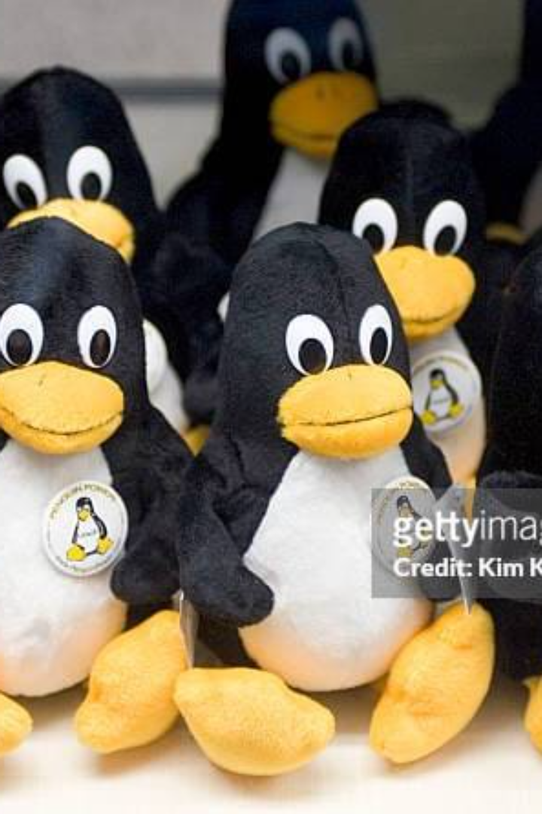
cp - Copy Files and Directories
The cp command is used to copy files and directories.
Usage: cp source destination
Example: cp file.txt /path
/to/destination/

Slide 9
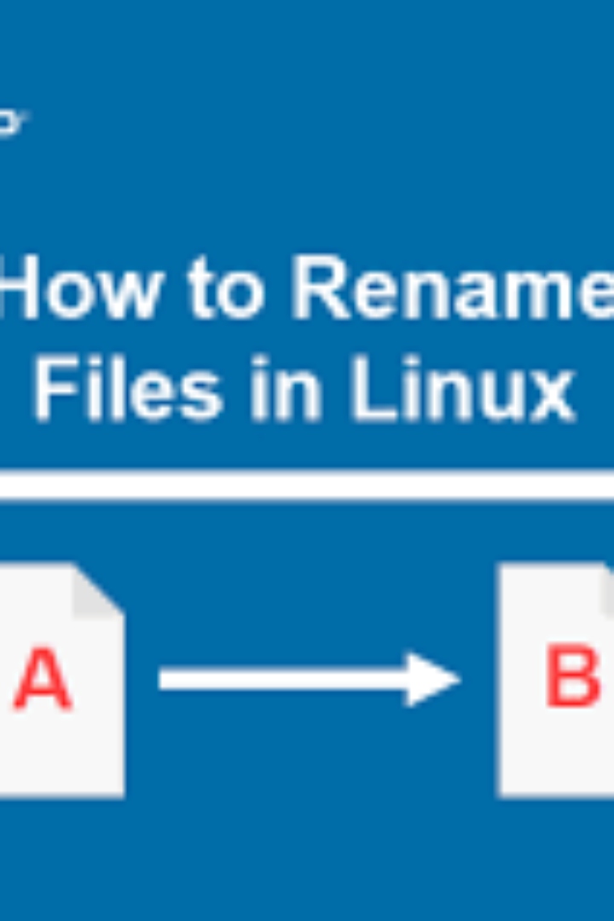
mv - Move and Rename Files
The mv command moves or renames files and directories.
Usage: mv oldname newname or mv source destination
Example: mv oldfile.txt newfile.txt or mv file.txt /newpath/

Slide 10
cat - Display File Contents
Use the cat command to display the contents of a file.
Usage: cat filename
Example: cat document.txt

Slide 11

grep - Search for Text Patterns
The grep command searches for text patterns in files using regular expressions.
Usage: grep pattern filename
Example: grep "search_term" file.txt

Slide 12

Conclusion
These 10 Linux file commands are fundamental for managing your files and directories efficiently on a Linux system. By mastering these commands, you can navigate your file system, create and modify files, and automate various tasks, making your Linux experience smoother and more productive.

Slide 13
Thank You
Thank you for your attention! Feel free to reach out if you have any further questions or need assistance with Linux file commands.

